Slide 1
The Last Week Of Jesus’ Life (Tuesday)
A Day Of Controversy
Matthew 22:15-33; Mark 12:13-27; Luke 20:19-40
June 8, 2022

Slide 2
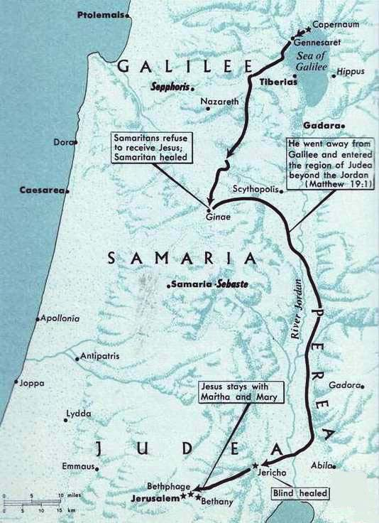
The Journey To Jerusalem
Crossed into the region beyond Jordan. Matthew 19:1
Samaritans refuse to receive Jesus. Matthew 19:1
Samaritan Healed. Luke 17:11
Stopped in Bethany.
Rested on the Sabbath day. John 12:1
Healed two blind men, visited Zacchaeus. Luke 18:35-19:10
About 1,200 feet below sea level.

Slide 3
Sunday
Preparation:
Secures the colt. Matthew 21:1-7
The Procession Into The City.
Multitude spread their garments on the road. Matthew 21:8
Shouts Of The People As Jesus Entered. Mark 11:9-10, “Blessed (is) the kingdom that cometh, (the kingdom) of our father David: Hosanna in the highest.”
My kingdom was not of this world. John 18:36

Slide 4
Sunday
The Response Of The Pharisees.
Matthew 21:14-15, “And the blind and the lame came to him in the temple; and he healed them. But when the chief priests and the scribes saw the wonderful things that he did, and the children that were crying in the temple and saying, Hosanna to the son of David; they were moved with indignation.”

Slide 5
Sunday
Prophecy of Jesus.
Luke 19:41-44, “And when he drew nigh, he saw the city and wept over it, saying, If thou hadst known in this day, even thou, the things which belong unto peace! but now they are hid from thine eyes. For the days shall come upon thee, when thine enemies shall cast up a bank about thee, and compass thee round, and keep thee in on every side, and shall dash thee to the ground, and thy children within thee; and they shall not leave in thee one stone upon another; because thou knewest not the time of thy visitation.”
Return to Bethany. Mark 11:11

Slide 6
Monday
Judgment upon the unproductive fig tree. Mark 11:12-14
Cast out the merchandisers. Mark 11:15-18
Return to the Mount of Olives (Bethany, Matthew 21:17; Luke 21:37), in the evening.

Slide 7
Tuesday
Jesus taught the disciples a lesson on faith, prayer and forgiveness from the withered fig tree. Matthew 21:20-22; Mark 11:20-26
Have faith in God.
Faith must be grounded in the word of God (cf. Romans10:17; Luke 22:42;1 John 5:14-15; cf. James 1:5-8).
Forgiveness. Mark 11:25; (cf. Matthew 6:14-15; 18:21-35)

Slide 8
Tuesday – A Day Of Controversy
Jesus Taught The People.
Chief priests and elders asked “by what authority …” Matthew 21:23
The Pharisees and Herodians asked a question about tribute to Caesar. Matthew 22:15-22
The Sadducees asked a question regarding the resurrection. Matthew 22:23ff
A Lawyer (scribe) asked a question about the great commandment. Matthew 22:34ff
Jesus asked the Pharisees a question regarding the son of David. Matthew 22:44ff
Jesus pronounced 7 woes against the scribes and Pharisees. Matthew 23
Jesus observed a widow casting two mites into the temple treasury. Mark 12:41ff
Jesus discussed with His disciples the destruction of Jerusalem and His second coming. Matthew 24

